Slide 2
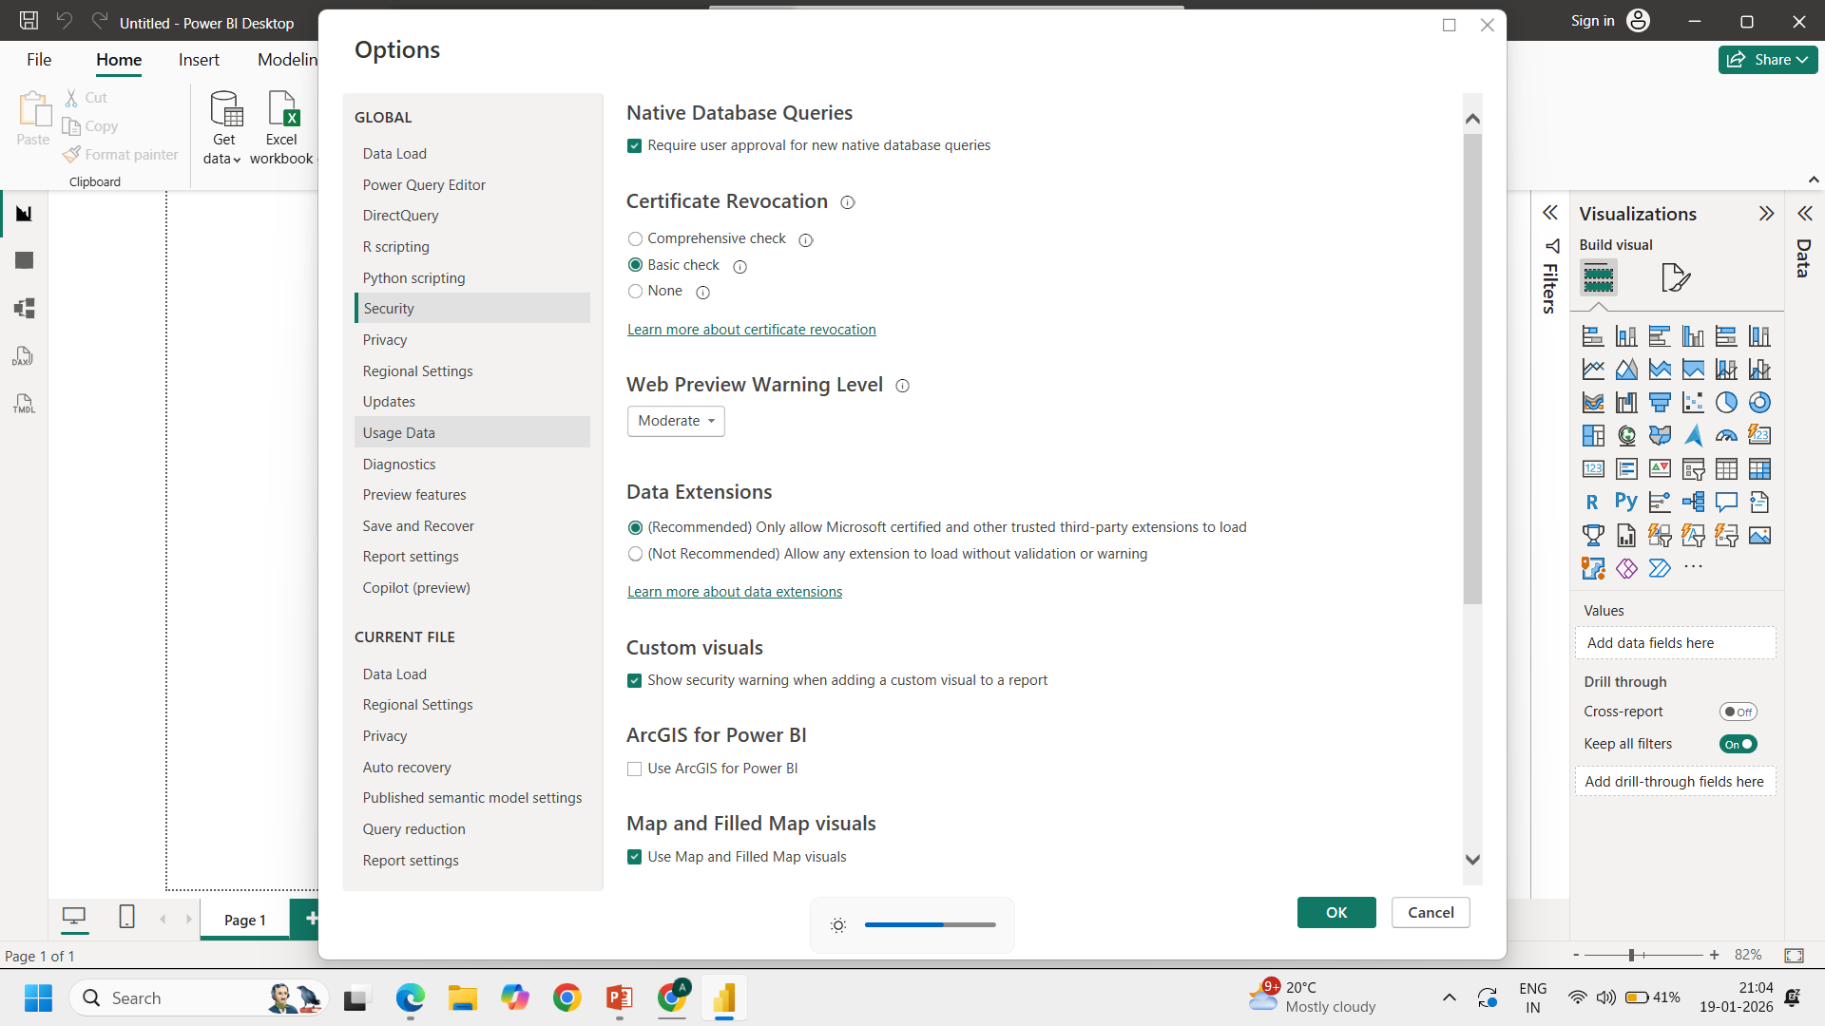

Slide 3
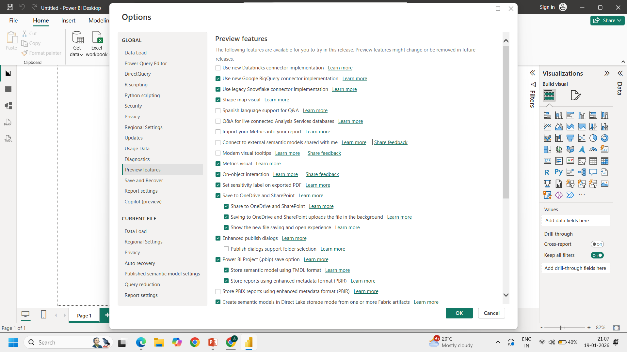

Slide 4
Restart PowerBI

Slide 5
For online users
-- go to tenant settings
Only one time settings
-- in app.powerbi.com
Check gearicon
-- admin portal
-tenant setting
-map and filled map visions
-allow bing max location

